Slide 1

Research Design
RESEARCH METHODOLOGY AND SCIENTIFIC WRITING
COMPUTER SCIENCE FACULTY, UNIVERSITY OF INDONESIA

Slide 2
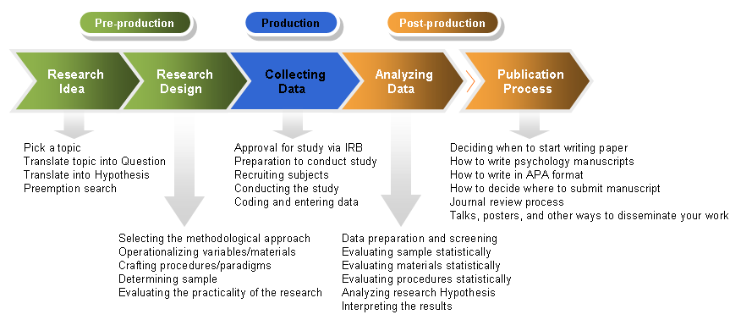
Research Design in Context
Source: http://dandelion-films.com/research-design

Slide 3
Method vs Methodology
Research Methods are the techniques / procedures used to collect and analyse data.
Research Methodology refers to discussions of how research is done, or should be done, and the critical analysis of methods of research.
This distinction is not clear cut, even in established literature! (Blaike, 2000:8)
Conceptual frameworks and assumptions used to inform research
Elaboration of research method
The paradigm that dictates which methods are used, and how they are applied and arranged.
Rule of thumb: if the research issue is straight forward, use method, but if the research issue is complex then use methodology.

Slide 4
Categories of Research Methods
By purpose:
Basic/fundamental/pure research
Applied research
By time:
Cross-sectional (at a specific point in time)
Longitudinal (over a period of time)
By methodology (mindset):
Quantitative, Qualitative, or a Combination
Exploratory vs. Experimental

Slide 5


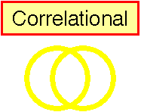


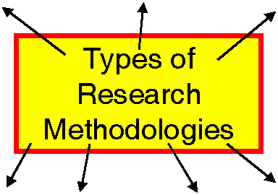








Research Methods that Research Methodology Can Be Built Upon

Slide 6

Experimental Research
Research that allows for the causes of behavior to be determined
What is an experiment?
A carefully regulated procedure where one or more factors are manipulated and all other factors are held constant
Cause-effect relationship occurs if:
The cause is correlated w/ the effect.
The cause occurred before the effect.
We can rule out other plausible explanations of the causal relationship

Slide 7
Factors in Experimental Research
Independent Variable (IV)
Factor that is manipulated / determined
Dependent Variable (DV)
Factor that is measured (processed from the IV)
Experimental Condition (group)
A group that is manipulated during the experiment (in which the IV is set)
Control condition (group)
Comparison group that is not manipulated (no pre-determined IV)
Confounding variable
An uncontrolled variable that is unintentionally allowed to vary systematically with the independent variable.

Slide 8
Quasi-experimental research
Almost but not quite real experiments, with no IV
Compare groups biased on naturally occurring variables
Two types of natural variables
Subject variable. Characteristics that vary between participants, but can not be manipulated
Time variable. Comparing individuals at different points in time (age 3 and 6)
One-shot posttest, no control group

Slide 9

Causal – Comparative Research
Ex Post Facto = Causal-Comparative Research
Explores possible causes and effects
The independent variable is not manipulated, it has already been applied
Focuses first on the effect, then attempts to determine what caused the observed effect.
Seeks to explain differences between two groups that have occurred

Slide 10
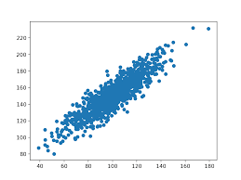
Correlational Research
Measure two variables
Determine degree of relationship between them
Correlation coefficient (e.g., r = 0.50)
Allows description and prediction of the relationship between variables
Unlike experiments, there are no attempts to control variables

Slide 11

Action Research
"Action research is a form of collective self-reflective enquiry undertaken by participants in social situations in order to improve on the rationality and justice of their own social or educational practices, as well as their understanding of their own social or educational practices and the situations in which these practices are carried out. “
Groups of participants can be teachers, students, principals, parents and other community members, - any group with a shared concern.
The approach is only action research when it is collaborative, though it is important to realize that the action research of the group is achieved through the critically examined action of individual group members.
Kemmis, Stephen & Robin McTaggart (eds) The Action Research Planner, 3rd edition, Victoria: Deakin University Press, 1988.

Slide 12

Historical Research
Steps of Historical Research
The recognition of a historical research problem or the identification of a need for certain historical knowledge
The gathering of as much pertinent information about the problem or topic as possible
If appropriate, the forming of hypotheses that tentatively explain relationships between historical factors (variables)
The selection, organization, and analysis of conclusion
The recording of conclusions in a meaningful narrative

Slide 13

Ethnographic Research
Ethnographic research involves field research and requires contextualization - the interpretation of result in the data collection.
Ethnographic studies focus on organizations, which consist of defined groups of people who interact in regular and structured ways.

Slide 14

Case Studies Research
Empirical investigation of particular phenomenon
A ‘case’ may be an organization, community, country, etc
Boundary problems should be determined
Multiple cases are suggested to compare and contrast different cases
Should be holistic and robust
Use qualitative and quantitative data
Guided by a hypothesis. “To examined why a particular company success or fail in using IT”

Slide 15

Survey Research
The survey is a group of research methods commonly used to determine the present status of a given phenomenon
A survey is a systematic method of collecting primary data based on a sample
Survey may be used for exploratory, descriptive and causal studies
Unlike case study, the purpose of a survey is not to consider a specific case in depth but to capture the main characteristics of the population at any instant

Slide 16
Surveys
Collecting standardized information
Typically gathers knowledge or opinions.
Use a standardized questionnaire with set questions.
Ideally the questionnaire has been validated.
Representativeness of the sample is very important.
Representativeness of the sample
Ensure randomness – recall sampling techniques and statistical analysis!

Slide 17
Statistical Analysis (Quantitative Research)
RESEARCH METHODOLOGY AND SCIENTIFIC WRITING
COMPUTER SCIENCE FACULTY, UNIVERSITY OF INDONESIA

Slide 18
Data
An important component of research is data
Data collection must be done objectively with an instrument
Quantitative vs qualitative data
Quantitative research is done using quantitative data

Slide 19
Data
Data dapat berupa:
Data disajikan dalam:
Numbers
Symbols
Images
Sound
Video
Interview
Tables
Graphs
Images
Figures
Excerpts

Slide 20
Data Yang Objektif
Data yang objektif, diperoleh secara ilmiah, yaitu dengan menggunakan berbagai instrument yang terdefinisikan dengan jelas (valid dan reliable).
Hasil pengambilan data dengan alat
Known dataset
Hasil eksperimen
Hasil pengamatan dengan alat tulis, alat rekaman
Hasil wawancara dengan pertanyaan tertulis terdokumentasi
Hasil survey dengan kuesioner yang terdokumentasi, dll.

Slide 21

Primary and Secondary Data
Primary
Data Collection
Secondary
Data Compilation
Print or Electronic
Observation
Survey
Experimentation

Slide 22
Quantitative Research: Definition
In sociology, quantitative research refers to the systematic empirical investigation of social phenomena via statistical, mathematical or computational techniques.
The objective of quantitative research is to develop and employ mathematical models, theories and/or hypotheses pertaining to phenomena.
Data kuantitatif adalah data empiris hasil dari suatu pengamatan (bisa hasil survey, hasil experiment, hasil observasi, dll.)
(Source: Wikipedia)

Slide 23
Types of Data
Types of Data
Discrete
Quantitative
Discrete
Qualitative
Continuous
You studied this in Statprob class!

Slide 24
What's the difference between these two statements?
I have seven apples
They are delicious
What's the difference?
We can count or measure the seven apples, but…
We can't put a number to how delicious they are. Those apples might be delicious to one person and be completely sour to another person.
(Source: http://study.com/academy/lesson/what-is-quantitative-data.html, March 2016)

Slide 25
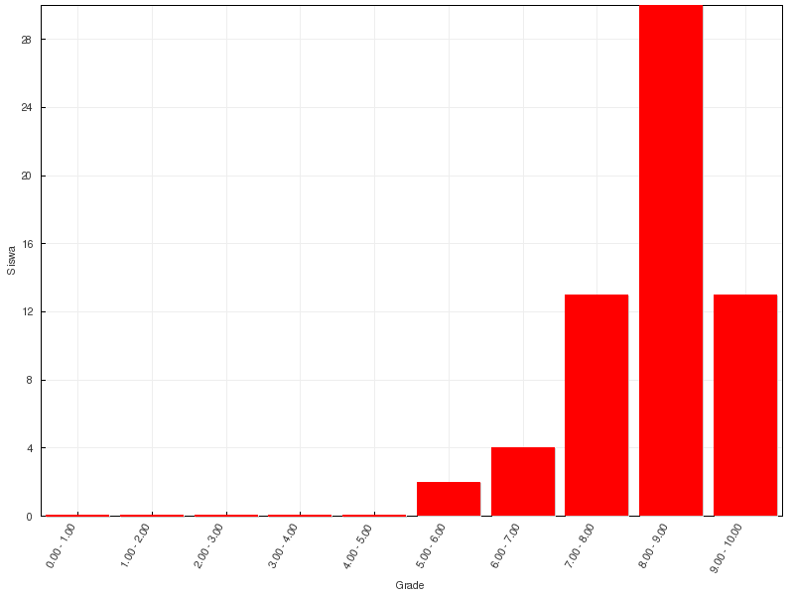
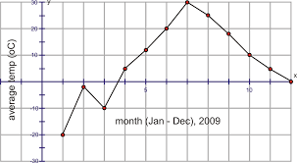
Quantitative or Numerical Data
You studied this in Statprob class!
Discrete Data
Only certain values are possible (there are gaps between the possible values).
Continuous Data
Theoretically, any value within an interval is possible with a fine enough measuring device.

Slide 26
Scales of Measurement
You studied this in Statprob class!
The data collected on variables are the result of measurement.
Not all measurement is the same:
Precise: the person is six feet, five inches.
Less-precise: the person is tall.
Precision of measurement of a variable is important in determining what statistical method should be used to analyze the data in a study.
Nominal scale
Ordinal scale
Interval scale
Ratio scale
More precise !

Slide 27
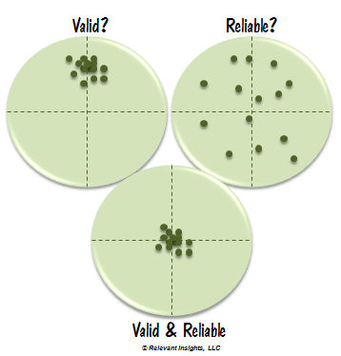
Validity and Reliability
Validity has no single agreed definition but generally refers to the extent to which a concept, conclusion or measurement is well-founded and corresponds accurately to the real world.
In normal language, we use the word reliable to mean that something is dependable and that it will give the same outcome every time.

Slide 28
Collecting Quantitative Data
You studied this in Statprob class!
Identify your unit analysis
Who can supply the information that you will use to answer your quantitative research questions or hypotheses?
Specify the population and sample
Information to collect
Specify variables from research questions and hypotheses
Define each variable
Choose types of data and measures
Locate or develop an instrument

Slide 29
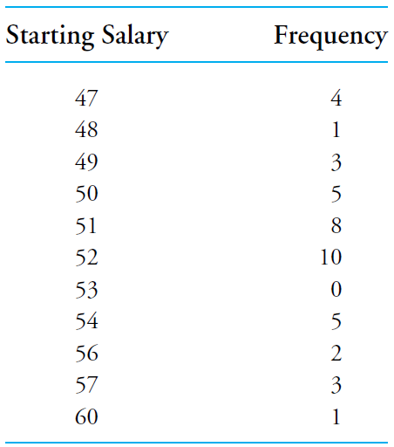
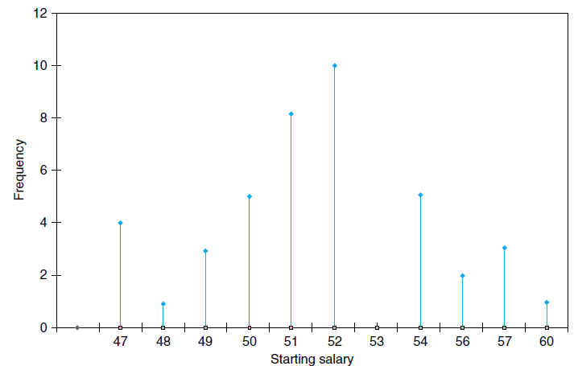
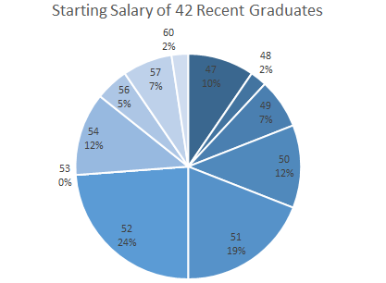
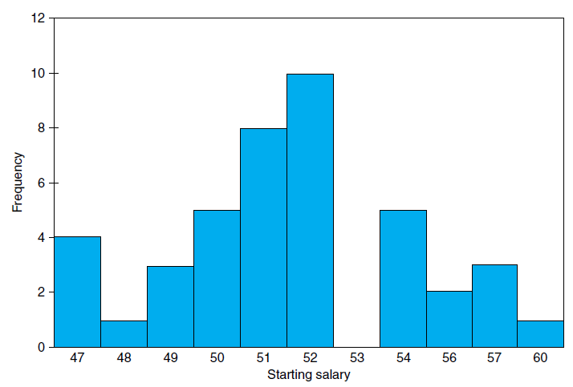
Presenting Data
You studied this in Statprob class!

Slide 30
Analyzing Quantitative Data
You studied this in Statprob class!
Measures of Central Tendency
Measures of Variance
Measures of Position
Mean
Median
Mode
range
mean deviation
variance
standard deviation
Percentile
Percentile Rank

Slide 31
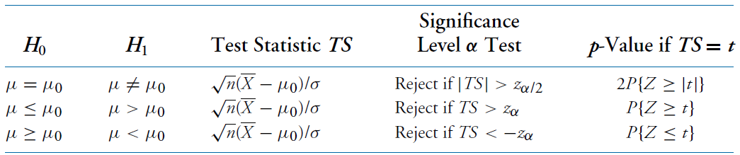
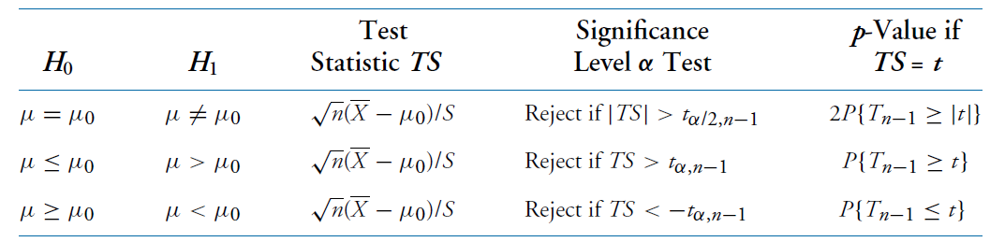
Hypothesis Testing
You studied this in Statprob class!
Assuming 1 normal population:
When σ is known
σ is unknown
It is also possible for 2 normal distributions
You studied this in Statprob class!

